Slide 1
The Next Williamsburg:
Getting in on the Ground Floor
Using MTA data to derive insights into prospective luxury building locations
Leonid Sim
Erick Walker
Kayla Starmer
Elena Dubova

Slide 2

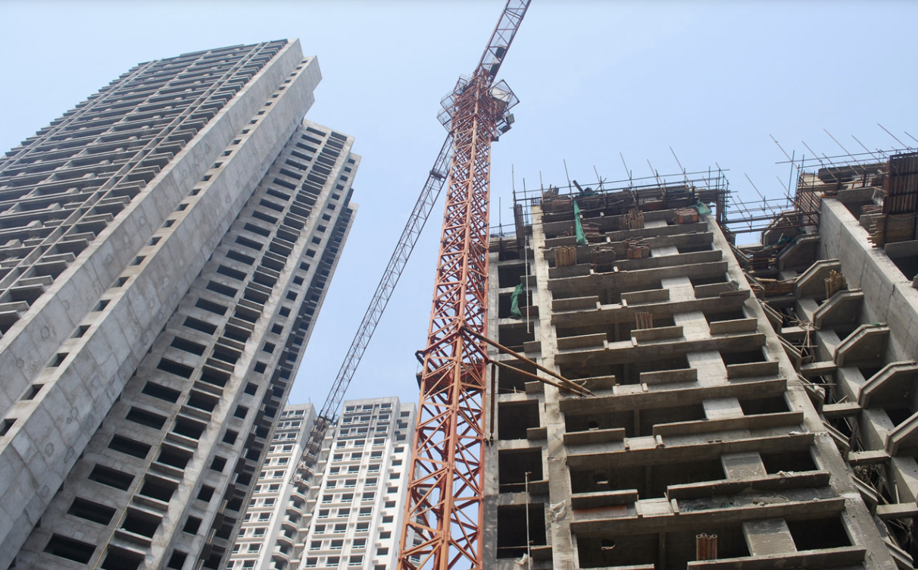
Our Project
Developer Challenges in NYC
Our Response
Oversaturated market
Competition
Profitability risks
Use data-driven approach to pinpoint promising locations for your next development site
Notes:
Backstory: As NYC has grown increasingly developed, the availability of desirable plots for additional development has declined. Developers (particularly in the high-end space) face the challenge of finding areas attractive to prospective tenants.

Slide 3



Criteria
Top Commuter Hubs
Average Household
Income
Origin Station Congestion

Slide 4

Methodology
Crown Heights South
Crown Heights North
Downtown Brooklyn
MTA Data
Sep - Nov 2019
Weekdays
7:00 AM - 11:00 AM
Prospect Lefferts Gardens
Top
Commuter
Hub
East Flatbush
EDA
Flatbush
Metrics:
Biggest commuter hubs
Locality to commuter hubs
Median income by neighborhood

Slide 5
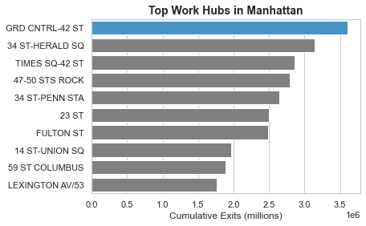
Results: Top Commuter Destinations
Insights from analyzing MTA data:
Traced subway paths feeding into Grand Central
Identified 456, and 7 lines
Brooklyn emerged for additional analysis

Slide 6
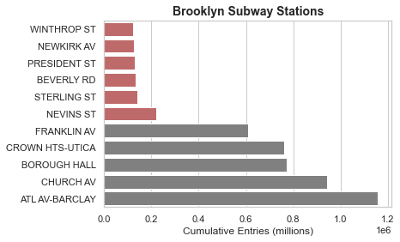
Brooklyn Stations Commuter Density
Insights from analyzing MTA data:
Sorted stations by number of morning entries
Selected less dense stations for further investigation
Income data to further segment locations

Slide 7
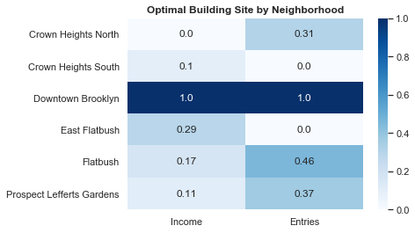
Income and Turnstile Entries Heat Map by Neighborhood
Notes:
Do we need the word Scaled here?

Slide 8
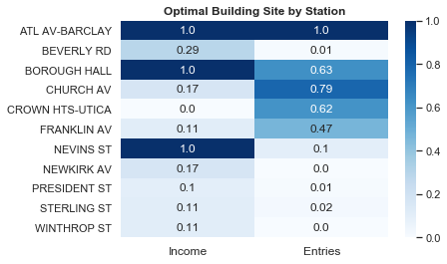
Income and Entries Heat Map by Station
*
*
*
* Downtown Brooklyn

Slide 9
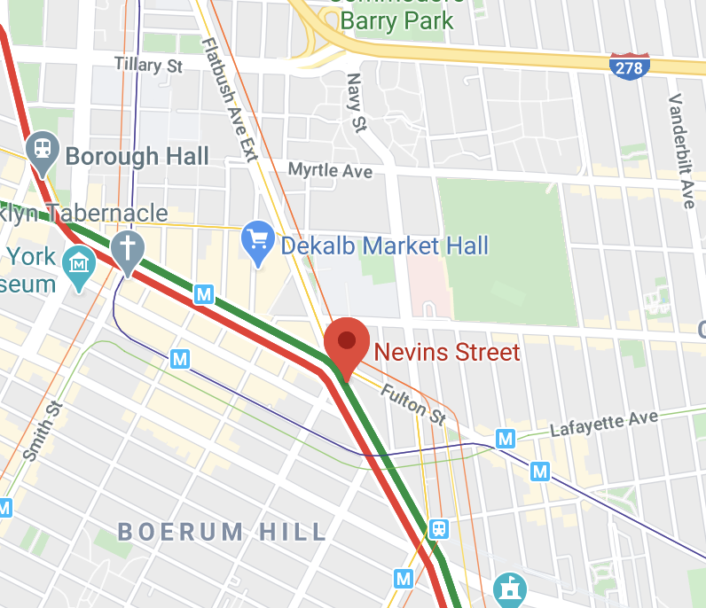
Recommendation: Invest in Nevins Street Stop
Locality to main commuter hubs
High neighborhood income levels
Origin station congestion
Notes:
Recommendations: Our recommendation based on our analysis is to build a luxury residential building in Downtown Brooklyn, specifically by the Nevins Street stop.
Insights: From looking at the MTA AND INCOME DATA from 2019, Downtown Brooklyn seems to have huge untapped potential when considering locality to main commuter hubs, residential income levels, and lack of origin station congestion.

Slide 10

Areas of Opportunity
Saturation levels of luxury buildings
Neighborhood desirability
Comparative analysis of subway lines
Impact of commute times
Analyze other boroughs
Notes:
We also identified a few areas of opportunity that could serve as potential future direction for the translation of our analysis
First, we should look at current luxury building saturation per area as this could have a direct impact on a developer’s ability to build
We also think it could be interesting to further examine commute times and neighborhood demographic and features (think whole foods, parks) - as this could provide compelling information for ranking the desirability of a neighborhood
Something else to consider in the future would be to explore alternate boroughs and subway lines, as many main commuter hubs are linked to several lines.

Slide 11
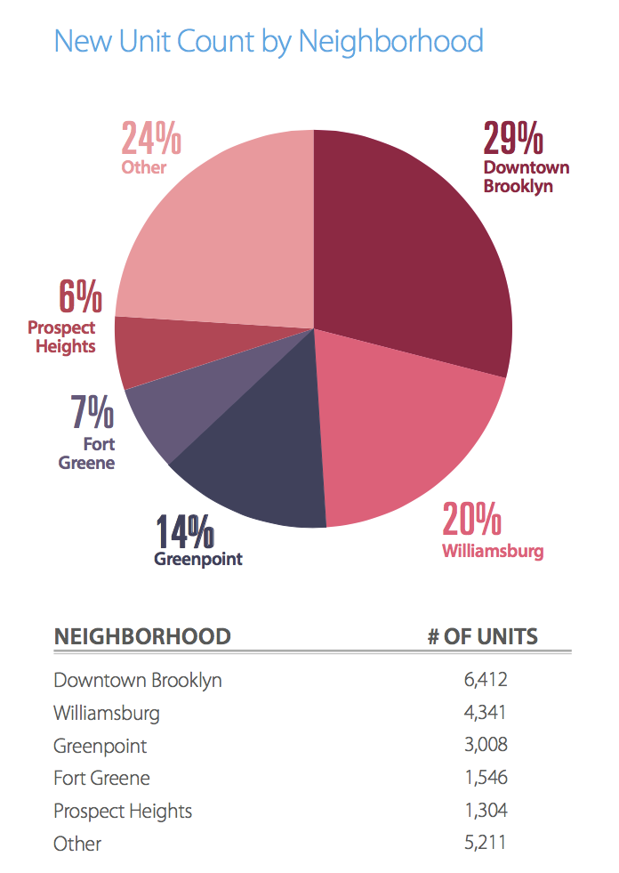
Source: Brownstoner 2020 Development Report
Notes:
After our initial EDA, we did some poking around in NEW YORK REAL ESTATE magazines, and interestingly enough, Downtown Brooklyn is the neighborhood slated with the most planned new unit counts for 2020.

Slide 12
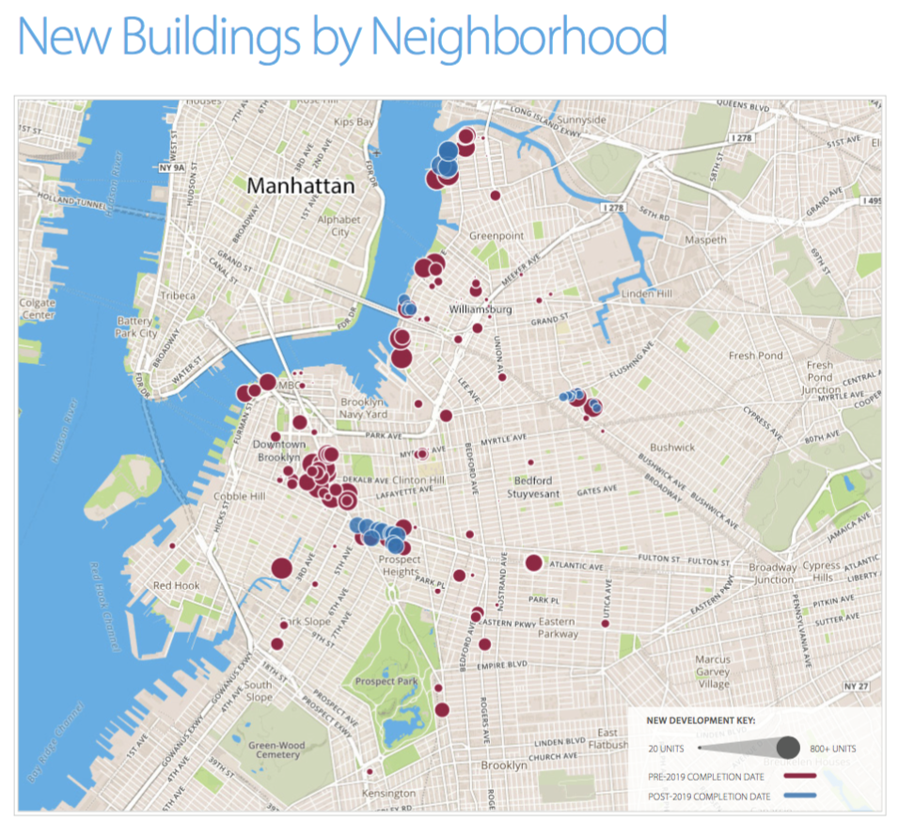
Source: Brownstoner 2020 Development Report
Notes:
And, if you look at the map, Nevins Street is the area around which most of the new developments are concentrated.
So, we’re confident that, if applied to future data sets, our analysis could provide insights into where to build.

Slide 13
Any Questions?

Slide 14
Appendix

Slide 15
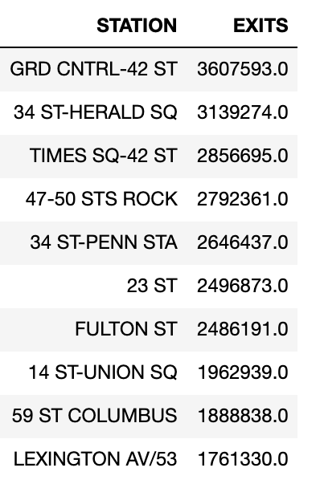
Exits by Station

Slide 16
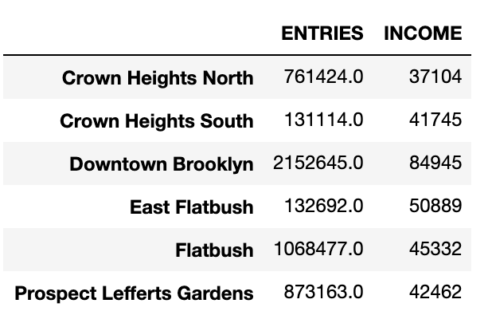
Entries and Income by Neighborhood

Slide 17
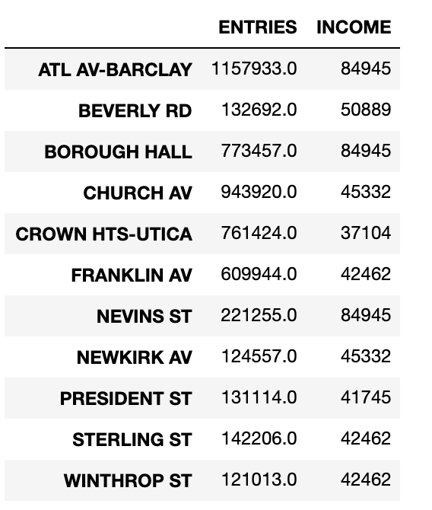
Entries and Income by Station

Slide 18
Sources
Turnstile data
Brownstoner 2020 Development Report
NY Curbed Median Income by Neighborhood

